Slide 1
Yantiq
AI-Based Early Arabic Reading Tutor with Pronunciation Correction
Mohamed Maged | Abdelrhman Ahmed | Ahmed Khaled | Adam Rani | Mohamed Ahmed
Supervised by Dr. Laila Shoukry | June 2026

Slide 2
Outline
Introduction and Motivation
Background
Problem
Literature Review
Available Solutions
Analysis, Requirements
Methodology and Design
Implementation
Evaluation and Results
Future Work (what will be completed second term)

Slide 3
Introduction and Motivation
The Challenge
Yantiq
AI-Based Early Arabic Reading Tutor
with Pronunciation Correction
Millions of children learn Arabic as their primary literacy language
Arabic pronunciation is complex: small differences change meaning
Children aged 4-7 are at a critical window — early habits persist
Limited access to guided, real-time pronunciation correction
Supervised by Dr. Laila Shoukry
Mohamed Maged | Abdelrhman Ahmed | Ahmed Khaled
Adam Rani | Mohamed Ahmed

Slide 4
Background
Early Arabic Literacy
Modern Standard Arabic (MSA)
Linking sounds, letters, and meaning for children aged 4-7
Formal Arabic used in education, media, and official contexts
ASR
CTC
Automatic Speech Recognition: converts spoken input to text
Connectionist Temporal Classification: maps audio to characters
Ground Truth
Confidence Score
Predefined correct expected answer for each learning item
Model certainty level supporting pronunciation evaluation
Gamification
Stars, badges, and levels used to motivate child learning

Slide 5
Problem
55.9%
of parents faced difficulty
teaching children correct Arabic
89.7%
of children start learning
Arabic between ages 3 and 6
97.1%
of survey respondents were
excited about the Yantiq concept
Most existing apps offer passive listening only — no real-time pronunciation check
Without immediate correction, wrong pronunciation habits form and persist
Gap: no child-safe interactive Arabic tutor combining listening, speaking, feedback, and progress tracking

Slide 6
Literature Review
Why Quran Muaalem?
Adaptation for MSA
Built specifically for Quranic Arabic — the most
rigorously pronounced form of the language.
Already handles Arabic phoneme recognition
and speech-based pronunciation evaluation.
No other public model targets Arabic
pronunciation evaluation at this specificity.
CTC output heads reduced from 43 to 35 to
remove Tajweed-specific classes and align
with Modern Standard Arabic (MSA) scope.
Fine-tuned on Mozilla Common Voice Arabic
for MSA pronunciation patterns.
Arabic-Phonetiser converts ground truth
text to expected phoneme sequences.
Pronunciation Evaluation Pipeline
Child Audio
Input
Quran Muaalem
(adapted, 35 CTC)
Phoneme
Prediction
Ground Truth
Comparison
Score +
Feedback

Slide 7
Available Solutions
Solution Type
Arabic
Support
Real-Time
Correction
Ground Truth
Compare
Gamifi-
cation
Adult
Dashboard
Static Arabic Apps
Yes
No
No
Partial
No
Video-Based Learning
Part.
No
No
No
No
Quran Recitation Apps
Yes
Partial
Partial
Partial
No
General Language Apps
Part.
Partial
Partial
Yes
Partial
Yantiq (Proposed)
Yes
Yes
Yes
Yes
Yes

Slide 8
Proposed Solution
Learning Path
Level 1
Letters
Level 2
Words
Level 3
Sentences
Recognize + Pronounce
Combine sounds
Early reading fluency
Child listens to target content, repeats it, receives immediate audio feedback
Adapted Quran Muaalem model: CTC output reduced from 43 to 35 classes for MSA
Phoneme-based evaluation: predicted phonemes vs. expected phonemes from ground truth
Gamification: stars, badges, level unlocking | Adult dashboard: progress + weak areas

Slide 9
User Analysis
Child User (Ages 4-7)
Parent / Guardian / Teacher
Audio-first interface: icons, sounds, minimal text
Listen to target content, speak, receive audio feedback
Earn stars, badges, and unlock next level
Simple navigation, no complex settings
Create and manage child profile
Monitor progress via adult dashboard
View scores, completed lessons, weak areas
Teacher: track multiple children
Survey Validation (68 respondents)
97.1%
excited about Yantiq concept
80.9%
prefer voice + fixed lesson duration
64.7%
prefer dedicated parent dashboard

Slide 10
Requirements
Functional Requirements
Non-Functional Requirements
Nice-to-Have Features
Child profile creation
Structured learning path: Letters > Words > Sentences
Voice recording + AI transcription
Ground-truth phoneme comparison
Score generation + audio feedback
Retry logic for incorrect attempts
Stars, badges, level unlocking
Adult dashboard + progress tracking
Response time under 2 seconds
Child-safe design, no unsafe content
HTTPS / JWT authentication
Scalable modular architecture
Cross-device mobile compatibility
Secure audio handling
AI voice companion
Adaptive personalized learning path
Detailed teacher dashboard
Group/classroom management
Dialect support
Web platform version

Slide 11
Methodology
AI Pronunciation Evaluation Pipeline
Child
Speaks
Audio
Recorded
Quran Muaalem
Inference
Phoneme
Comparison
Score +
Feedback
Mic input
Mobile app
35-class CTC
(MSA scope)
vs. Ground Truth
(Arabic-Phonetiser)
Audio to child
Development Approach
Incremental: GP1 = research, design, AI adaptation | GP2 = full implementation
Educational: gradual path Letters > Words > Sentences with short fixed-duration lessons
Progress tracking: each attempt stored; results feed adult dashboard and gamification rewards

Slide 12
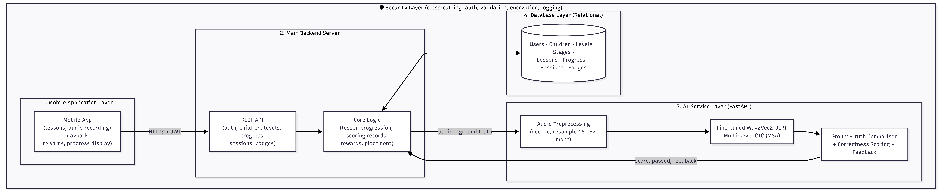
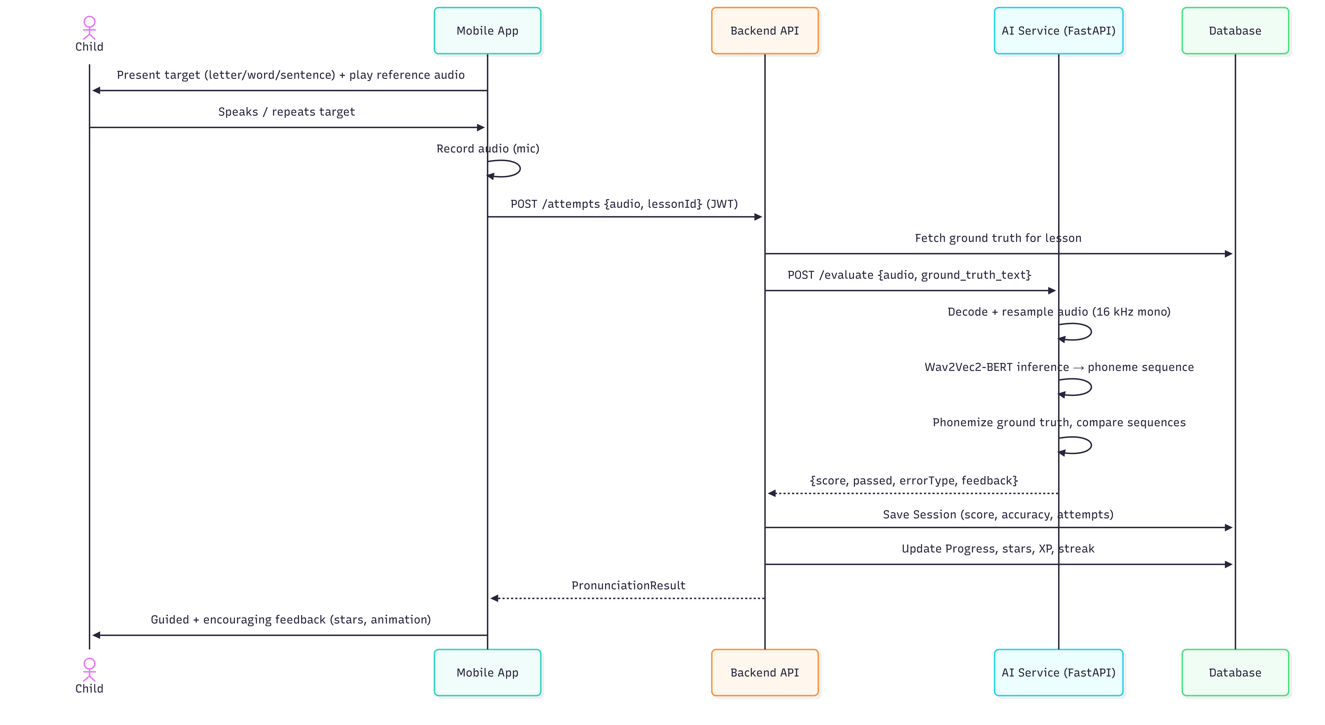
System Design
System Architecture Diagram
Pronunciation Evaluation Sequence Diagram

Slide 13
Available Datasets
Mozilla Common Voice Arabic
Selected Dataset
Open-source, large, crowd-sourced Arabic speech
Pro: diverse speakers, publicly available
Con: limited tashkeel (short vowels / diacritics)
Mozilla Common Voice Arabic chosen for fine-tuning
Best available open-source Arabic speech resource
Covers diverse adult speakers of MSA
Quran Muaalem Training Data
Known Limitation
Highly vowelized Arabic speech
Con: Quranic domain — not aligned with MSA scope
Insufficient tashkeel reduces vowelized MSA accuracy
Future: supplement with child-specific,
tashkeel-rich, curriculum-aligned data

Slide 14
AI Model: Quran Muaalem Adaptation
Adaptation Steps
Base: Quran Muaalem (obadx, HuggingFace) — Arabic CTC model
Original: 43 output classes (Arabic letters + Tajweed rules)
Adapted: 35 classes — Arabic letters + required special tokens only
Fine-tuned on Mozilla Common Voice Arabic for MSA patterns
Arabic-Phonetiser converts ground truth to expected phoneme sequence
Partial testing: good initial results; tashkeel gap noted for GP2
43
CTC
classes
(original)
8 Tajweed-specific classes removed
35
CTC
classes
(adapted)
Quran Muaalem (Quranic + Tajweed)
Yantiq Model (MSA letters + tokens)

Slide 15
Implementation
Mobile Application (Flutter / Dart)
Backend Server (Python FastAPI)
AI Service Layer (Python + Quran Muaalem)
Database (MySQL - relational schema)
Security Layer (HTTPS + JWT + input validation)
GP1 Completed
GP2 Planned
System architecture + UI/UX design
Model CTC adaptation: 43 to 35 classes
Fine-tuning started on Common Voice Arabic
Full Flutter mobile app + FastAPI backend
MySQL database + AI service integration
Complete testing, user evaluation, delivery

Slide 16
Prototype
Child Interface Screens (UI/UX)
Adult Interface + AI Prototype
Home screen + learning map
Lesson screen with audio playback
Pronunciation / recording screen
Result + feedback screen
Badges and rewards screen
Dashboard: progress, scores, weak areas
Child profile creation and management
AI: Quran Muaalem adapted (35-class CTC)
Partial testing on Arabic letters and words
Full audio integration planned for GP2
GP1 Status: UI/UX Design Complete
Figma prototype ready — awaiting implementation in GP2
AI Prototype: Partially Tested
Model adapted and fine-tuning in progress

Slide 17
Evaluation Plan
Metric 1 | Phoneme Prediction Accuracy
Metric 2 | Classification Accuracy
Predicted phoneme sequence vs. expected from ground truth
Correct / incorrect result across letters, words, sentences
Metric 3 | Confidence Score Reliability
Metric 4 | AI Response Time
Does score support reliable borderline decisions?
Target: under 2 seconds per evaluation attempt
Metric 5 | Error Analysis
Types of errors: similar sounds, tashkeel, noise
User Evaluation (GP2): usability testing with children and adults across varied speakers, speeds, and audio qualities

Slide 18
Conclusion and Future Work
GP1 Contributions
GP2 Roadmap
Problem validated via 68-respondent survey
Requirements defined: functional + non-functional
UI/UX design prototype completed (child + adult)
System architecture designed (5-layer modular)
Quran Muaalem adapted: CTC 43 to 35 for MSA
Full Flutter app + FastAPI backend + MySQL
Complete AI service integration + end-to-end testing
Model improvement: tashkeel-rich data + child samples
Usability evaluation with real users
Delivery: December 2026
Long-Term Vision
Adaptive learning path | AI voice companion | Teacher dashboard | Dialect support | Web version

Slide 19
References
[1] Graves et al. (2006). CTC: Labelling Unsegmented Sequence Data. ICML.
[2] Baevski et al. (2020). wav2vec 2.0: Self-Supervised Speech Representations. NeurIPS.
[3] Chung et al. (2021). W2v-BERT: Contrastive + Masked Language Modeling.
[4] Radford et al. (2023). Robust Speech Recognition via Large-Scale Weak Supervision. ICML.
[5] obadx. Quran Muaalem / muaalem-model-v3_2. GitHub / Hugging Face. June 2026.
[6] nawarhalabi. Arabic-Phonetiser. GitHub Repository. Accessed June 2026.
[7] Mozilla Common Voice. Arabic Speech Dataset. Mozilla Data Collective. June 2026.

Slide 20
Thank you Questions?

